Slide 1
AHS Girls Track and Field
Parent Meeting
Please sign in

Slide 2
Meet the Coaches
Coach Anderson: canderson@altonschools.org, 474-2700 ext. 12214
Coach Talbert: ttalbert@altonschools.org
Coach Absher: eabsher@altonschools.org
Coach Beile: Volunteer Throws Coach
GroupMe and Google Classroom

Slide 3
Attendance
Attendance is MANDATORY
If you can’t be at practice, you need to let a coach know BEFORE 1:25 (after lunch)
Failure to attend practices will result in you being dismissed from the team
*Reasons for missing practice must be ABSOLUTELY VALID, forgetting clothes is not a valid excuse*

Slide 4
Schedule
Go over schedule/changes
Altonschools.org - athletic page

Slide 5
Academics/College Recruitment/Goal Setting
Athletes need to maintain passing grades to participate weekly.
Excused and unexcused absences will affect grades and participation.
Failing grades will result in ineligibility, and possible removal from sport.
By Sophomore year, athletes will set post-high school goals (college, trade school, career path, etc.)
Juniors/Seniors will be required to look into/express interest in colleges.
Coaches will assist in college interest/recruitment process.
***Weekly Athletic Study Halls will begin during outdoor season***

Slide 6
Physicals/Requirements
Updated physicals need to be turned in prior to participation.
Mrs. Campion will contact athletes if physicals need to be updated during season
Please refer to the Alton Athletic Page for forms and agreement letters:
https://altonathletics.org/main/filesLinks/

Slide 7
Injuries
It is the athlete’s responsibility to inform coaches about aches and pains.
Andy Renner - Athletic Trainer
Medical recommendation to get aches/pains evaluated before continued participation.
We will not run athletes on repeated injuries.

Slide 8
Nutrition/Meet Snacks Help?
Athletes need to steer clear of the following during this season:
Hot chips
Sodas
Candies
Empty calories
Instead, they need to be eating:
Lean Proteins (fish, chicken, beans, etc.)
Healthy Carbs (pasta, rice, oatmeal, whole grain bread)
Dairy
Fruits, vegetables, nuts
Parents can volunteer to help bring healthy snacks for track meets.
Google Document to be created
Examples:
Fruit
Granola/Nutrigrain Bars
Sandwiches
Fruit Snacks
Water

Slide 9
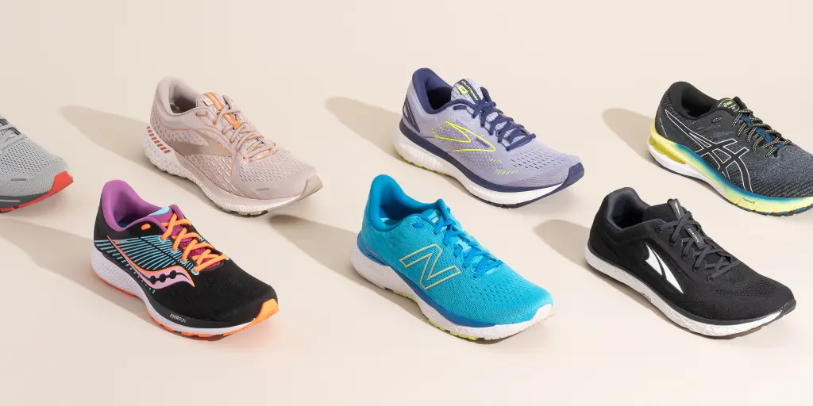
Shoes & Attire
Practice:
Shorts, tights, tshirts, tank tops, sweats, hoodies
Running Shoes
Spikes when needed
Meets:
School issued Uniform
T-shirt/shirt with sleeves
School Issued Warm-Ups
School issued UNIFORM
Layers (when needed)
RUNNING SHOES
Spikes

Slide 10
ADDITIONAL QUESTIONS?!

